Slide 1


Slide 2
Smart technology
Group Member:
1)Bishwazid Roy 152-15-6018
2) Debdulal Das Nibir 152-15-6077
3)Rakesh Barman 152-15-5786
4) Niaz Morshed 152-15-5930

Slide 3

What is smart technology
The technologies (includes physical and logical applications in all formats) that are capable to adapt automatically and modify behavior to fit environment, senses things with technology sensors, this providing data to analyze and infer from, drawing conclusions from rules

Slide 4
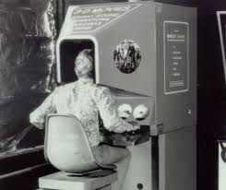
History
Smart Technologies introduced the first Smart Board interactive whiteboard technology. In 1992, Smart formed a strategic alliance with intel Corporation. In 2011, the Smart Technologies Headquarters in Calgary, Alberta, received Leadership in Energy and Environmental Design(LEED) Gold standard certification.

Slide 5
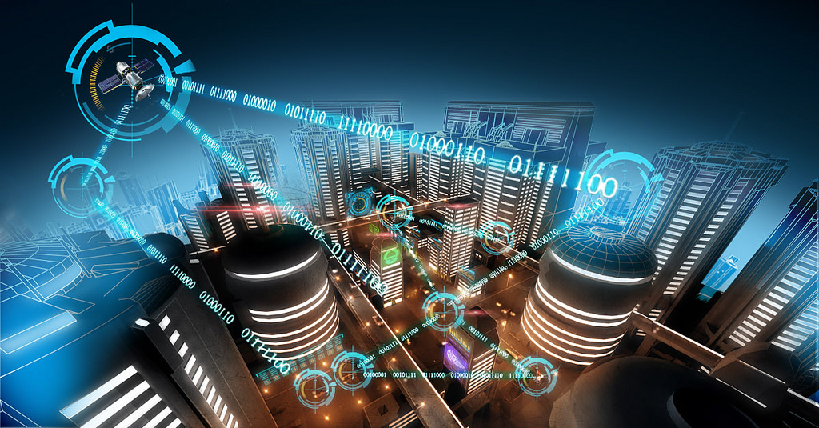
Smart technology in communications

Slide 6
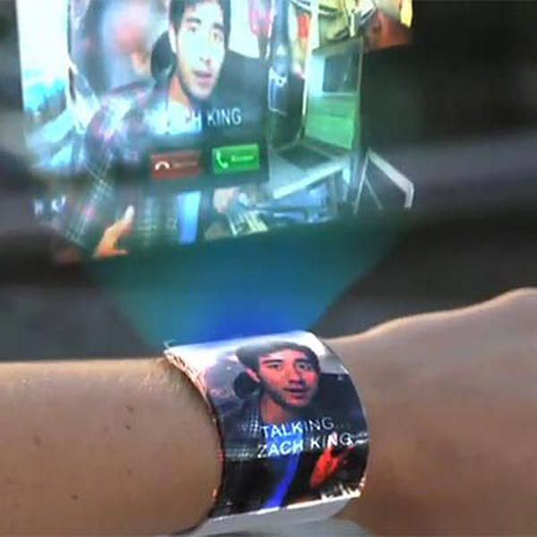
Smartwatch:
The smartwatch is a wearable gadget which keeps our hands free and yet allow us to use our smart phone which might be at home while we are away from home.

Slide 7
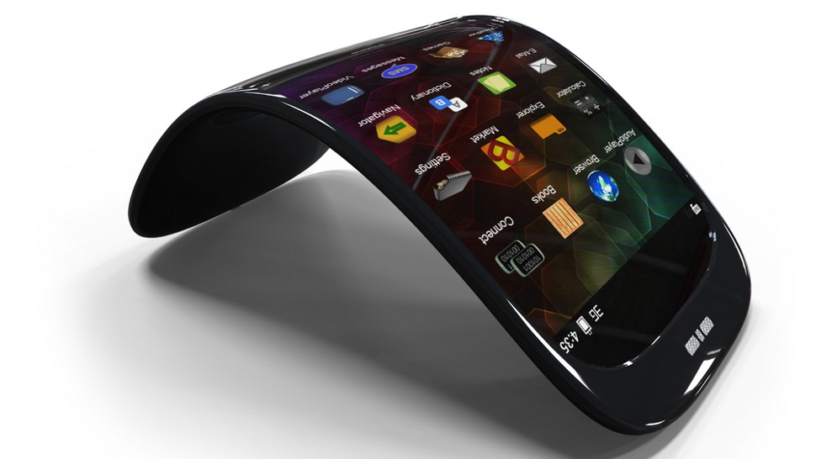
Smart phone
A smartphone is a mobile phone that presents more advanced computing capabilities and connectivity than the modern characteristic phone. Has powerful processes , memory, large screens open OS.

Slide 8
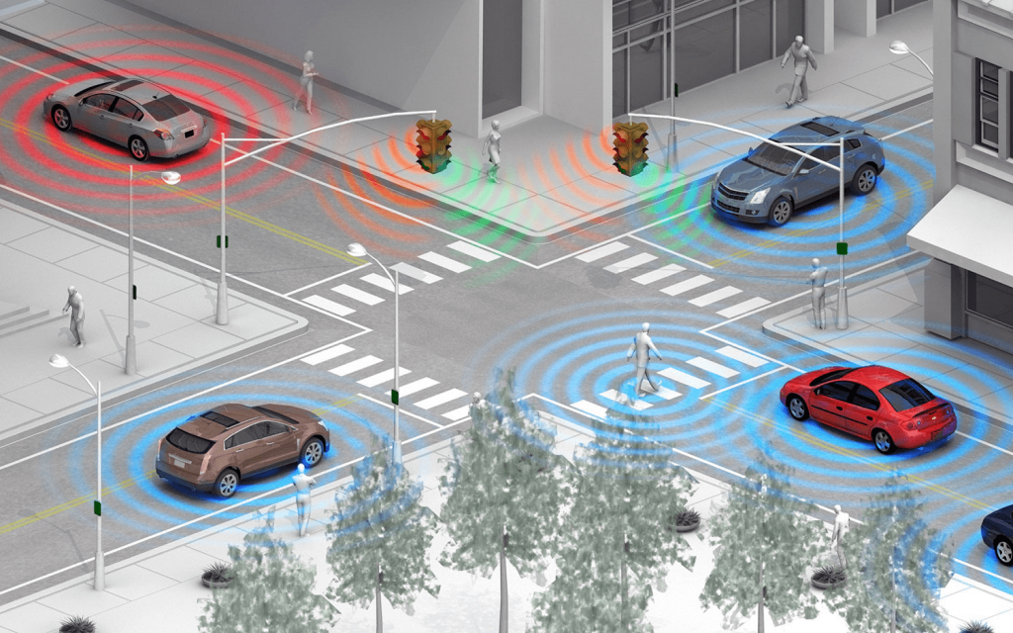
Smart transportation

Slide 9
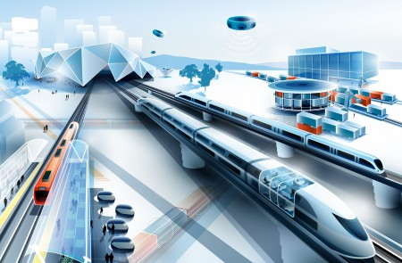
Smart Train
Virtual Ticketing system, using smart card and smart pay, High-Speed and Hyper-Speed , Passenger Entertainment, Digital Signage ,

Slide 10
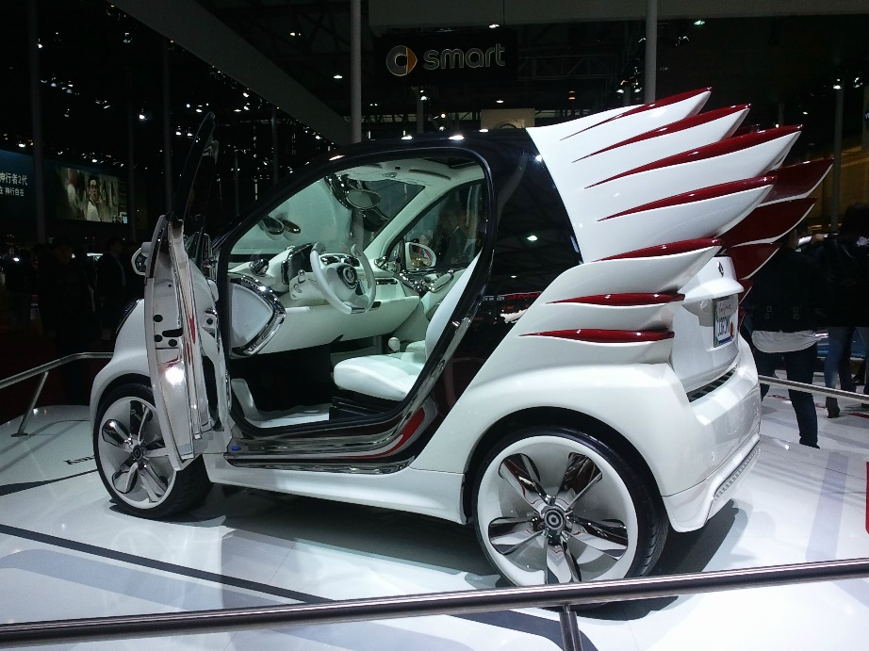
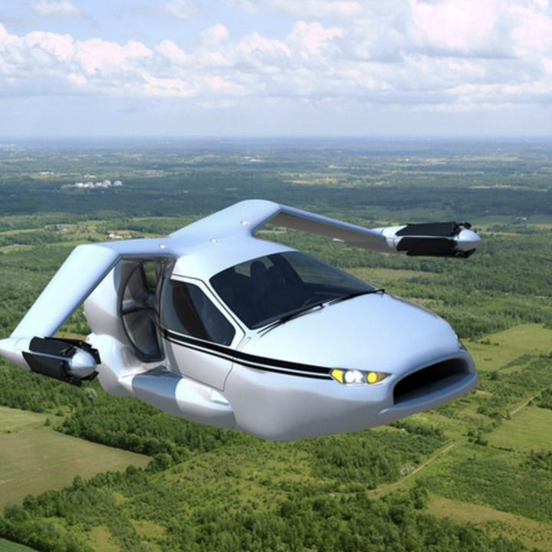
Smart car: Some of the car are electric, Driverless Cars,

Slide 11

Jetpack: Carry 10 gallon fuel, small skill airplane engine, reach over 10000 feet, can fly 15min-20min and speed 120mile ph.

Slide 12
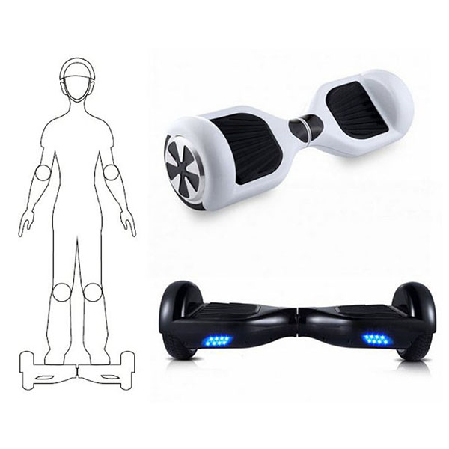
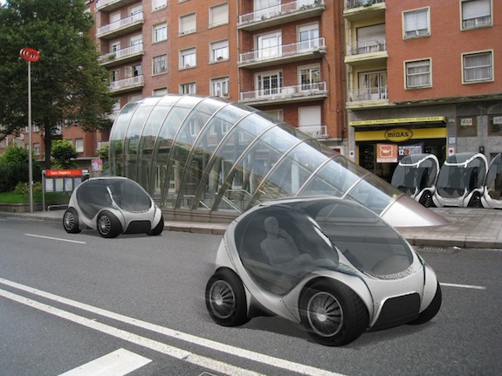
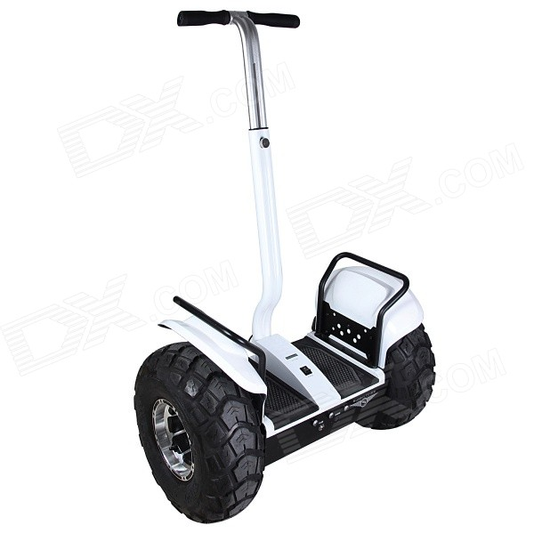
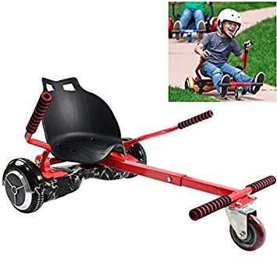
Self Balance Two Wheel Scooter

Slide 13

Problems of Transport : 1)Traffic Movement and Congestion 2) Parking Difficulties 3) Environmental Impact 4) Traffic Noise 5) Atmospheric Pollution
Transportation Solutions

Slide 14


Smart Technology in Health
Healthcare changes dramatically because of technological developments, from anesthetics and antibiotics to magnetic resonance imaging scanners and radiotherapy. Future technological innovation is going to keep transforming healthcare.

Slide 15
Type of Technology used in Health
1.technology in everywhere in medicine
2.Research into problems
3.better treatment options for various Ailment and diseases
4.Improved prediction of diagnosis and life expectance
5.Electronics health records
6.Personal health records
7.E-prescribing
8.Online communities

Slide 16
Advantage
Patient can use many kinds of test machines for identify the diseases.
Can use Smart health apps
Online prescription
Improve quality of life
Disadvantage
Not all people use smart phones
The privacy of the patient health information

Slide 17
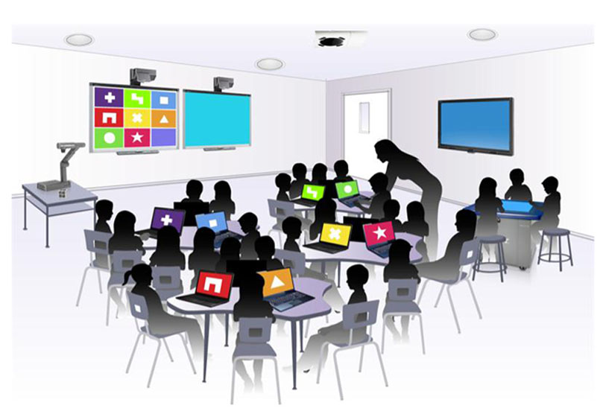

Smart Technology in Education
Education technology is a field study which is concerned with the practice of using educational methods and resources for the ultimate goal of faciliting the learning progress.

Slide 18
Type of technology used in education
1.Smartboards
2.Classrooms PC
3.Projectors
4.Television

Slide 19
There are two types of impact in Educaion technologies
Positive Impact:
1.Enhanced Teaching and Learning
2.Globalization
3.No Geographical Limitations
Negative Impact:
1.Declining Writing Skills
2.Incrasing Incidents of Cheating
3.Lack of Focus

Slide 20
Advantage
It makes students more excited to learn
Help student with busy schedules , freedom to work at home on their own time
Train students to learn new technology skills they can use later in the workplace
Disadvantage
Many experts and experienced people say that, due to such technology in education ,students imagination is affected.
It is costly to install such technology
There can be health issues when used over limit

Slide 21
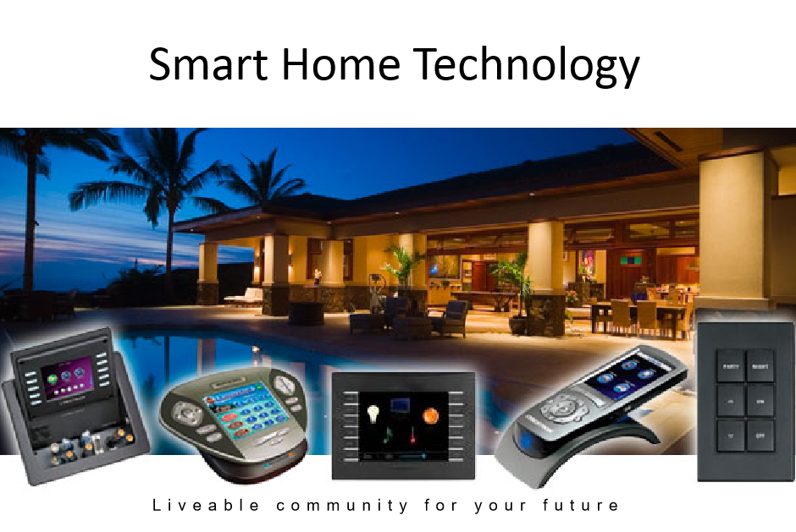

Slide 22
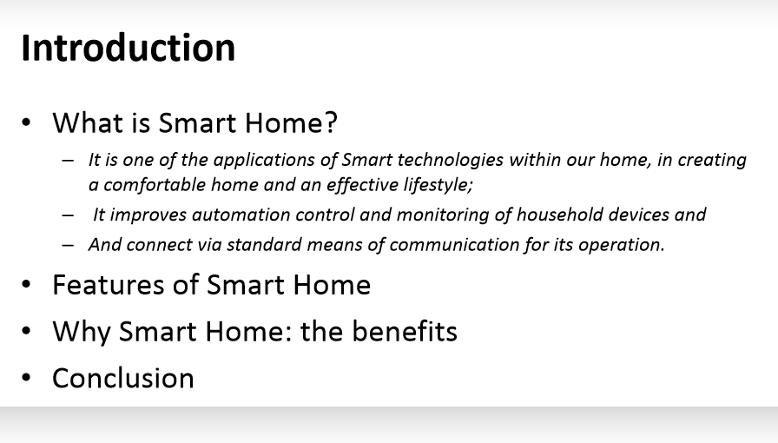

Slide 23
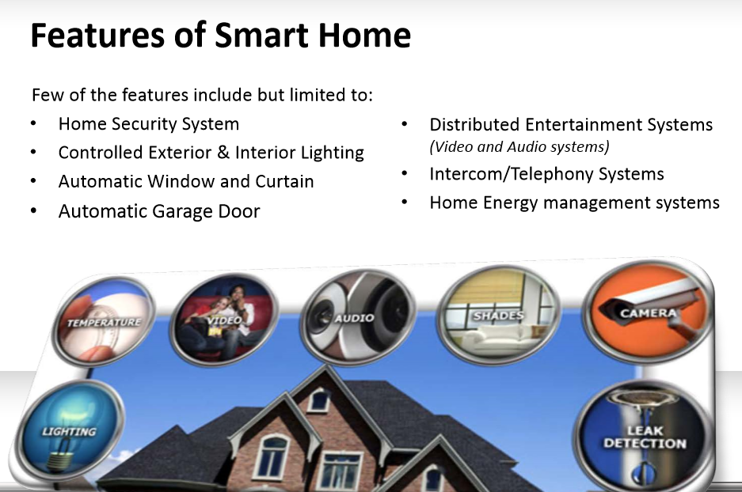

Slide 24
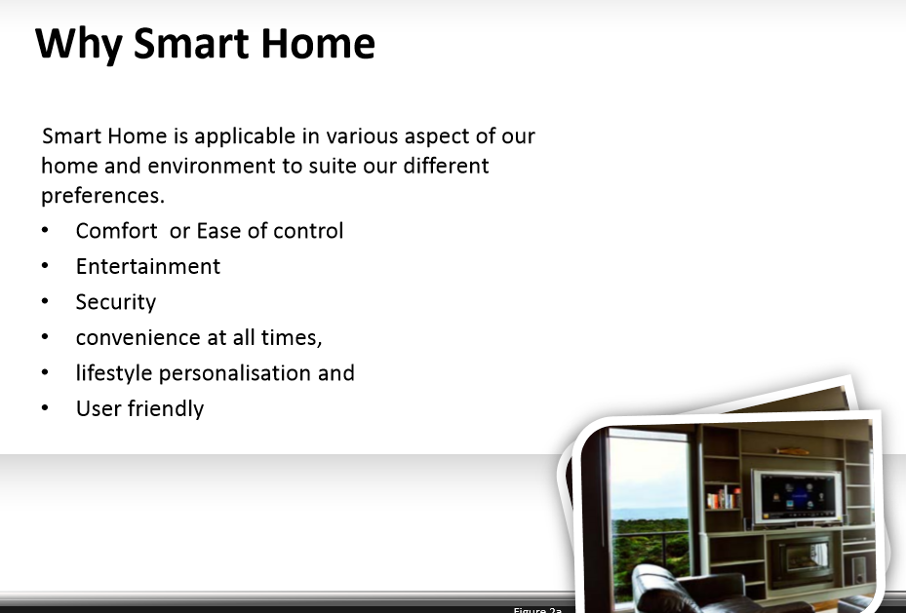

Slide 25
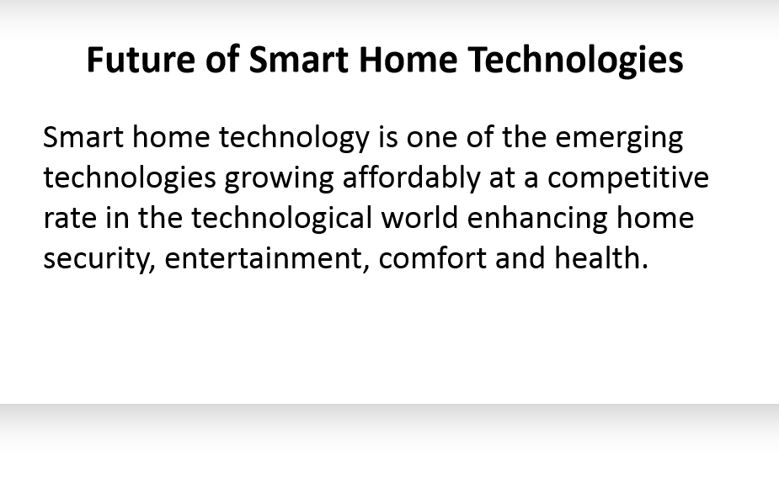

Slide 26
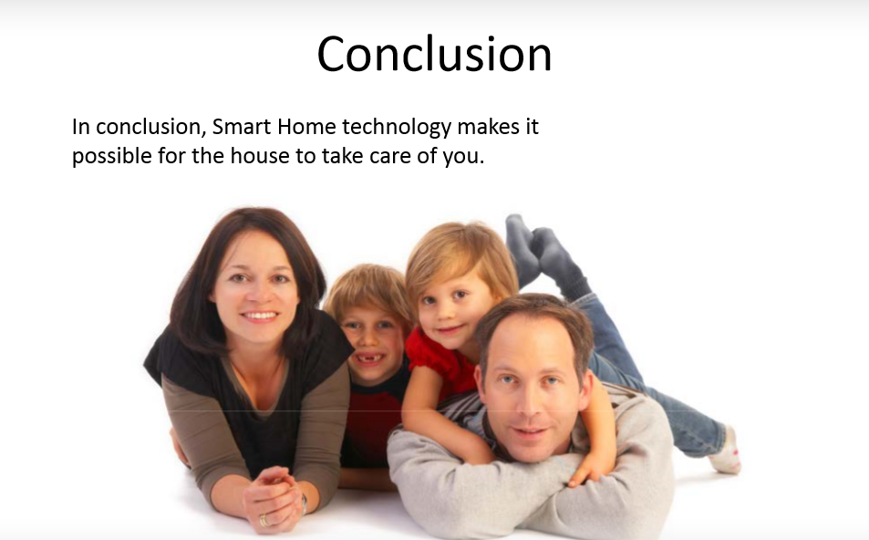

Slide 27
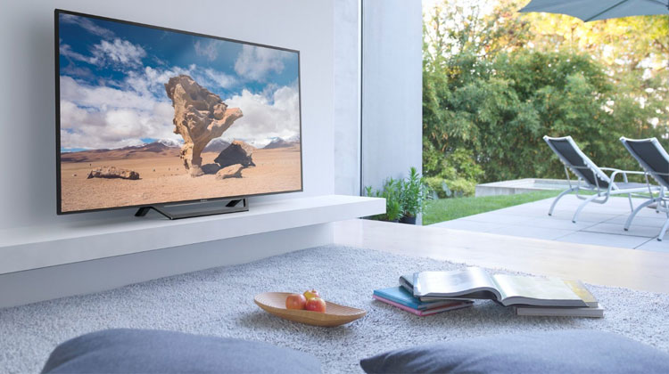
Smart Technologies in Entertainment

Slide 28
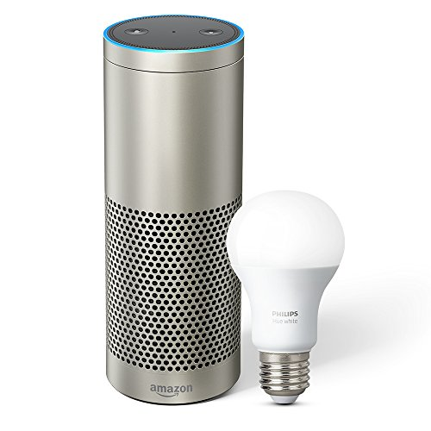
Amazon Echo Plus
The heavy hitter in Amazon’s new lineup of Alexa powered devices, the Echo Plus combines all of the functionality of the excellent Amazon Echo voice controller alongside a dedicated built-in ZigBee smart hub for effortlessly controlling all of the devices within your smart home environment.

Slide 29
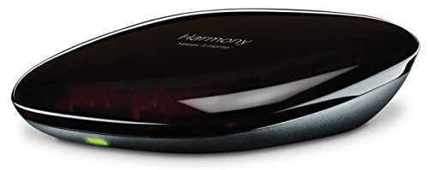
Logitech Harmony Home Hub
The Logitech Harmony uses a free companion app to allow you to take full control of up to 8 smart home entertainment devices using your smartphone as a control interface.
At the center of your smart home entertainment setup, the Harmony Hub is capable of orchestrating all of your connected devices and brings the whole thing together.

Slide 30
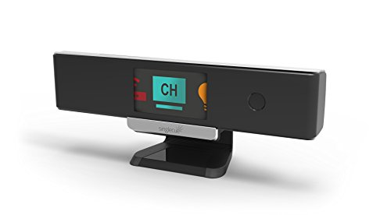
Singlecue Gen 2 Remoteless Gesture Controller
If you’ve ever wanted to control the smart devices in your home with the wave of a hand, then you need to check out Singlecue.

Slide 31

How technology is going to shape farming of the future

Slide 32
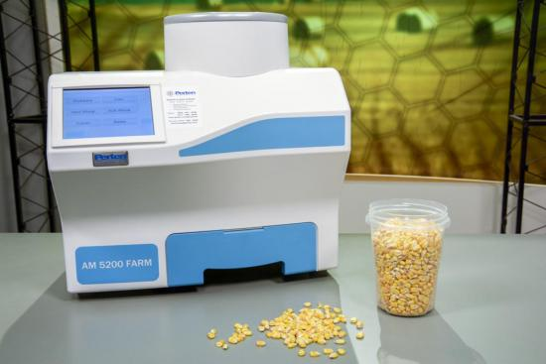
PERTEN AM 5200 FARM GRAIN MOISTURE TESTER
The system can test hot grain; provides moisture, test weight, and temp reading in 25 seconds; and will store test results, including field and farm names.

Slide 33
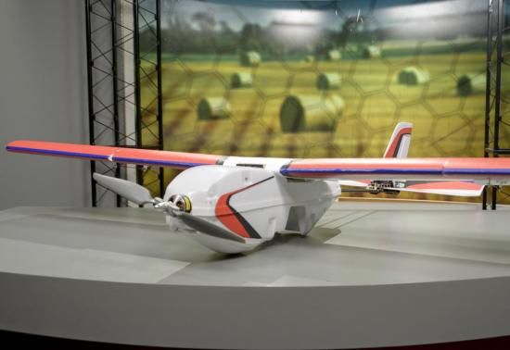
PRECISION HAWK LANCASTER
The highly customizable lancaster is four feet wide, weighs three pounds, and can carry payloads of up to two pounds.

